Slide 1
TOPIC A:
DATABASES
LESSON A-15
DATA WAREHOUSES

Slide 2
AGENDA
Operational Databases
Data Warehouses
Subject-oriented
Integrated
Time-variant
Non-volatile
Case Studies
Real-time Refresh
NOTE!
Have a way to take notes available for this lesson

Slide 3

THE WARM UP QUESTION
If a company has a database of every sale made today, do they know what they will sell next year?

Slide 4
THE WARM UP ANSWER
Not necessarily
This is the difference between Knowledge and Data
We can’t know the future using data
We can use inductive reasoning to predict the future
How does the structure of data influence how certain we are in our knowledge?

Slide 5
OPERATIONAL DATABASE
If I delete a record here because the customer returned an item, can I still see that the returned happened?
How about in 5 years’ time?
SaleID | Product | Price | Timestamp
1 | Jam | 2.99 | 1/3, 11:27 AM
2 | Peanut Buuter | 3.99 | 1/4, 4:30 PM
3 | Jelly | 3.49 | 1/4, 5:11 PM
4 | Bread | 5.99 | 1/5, 6:10 AM

Slide 6
OPERATIONAL DATABASE
This is an operational database
These are used in the ‘now’
When data changes or is removed, it means we can’t access the older versions of it
To understand patterns over time then, we need a “Vault” of data
SaleID | Product | Price | Timestamp
1 | Jam | 2.99 | 1/3, 11:27 AM
2 | Peanut Buuter | 3.99 | 1/4, 4:30 PM
3 | Jelly | 3.49 | 1/4, 5:11 PM
4 | Bread | 5.99 | 1/5, 6:10 AM

Slide 7
OPERATIONAL DATABASE
If we only store the current state of a database, are we destroying the evidence required to make historical claims?
Does “truth” in a database only exist in the present moment?
SaleID | Product | Price | Timestamp
1 | Jam | 2.99 | 1/3, 11:27 AM
2 | Peanut Buuter | 3.99 | 1/4, 4:30 PM
3 | Jelly | 3.49 | 1/4, 5:11 PM
4 | Bread | 5.99 | 1/5, 6:10 AM

Slide 8
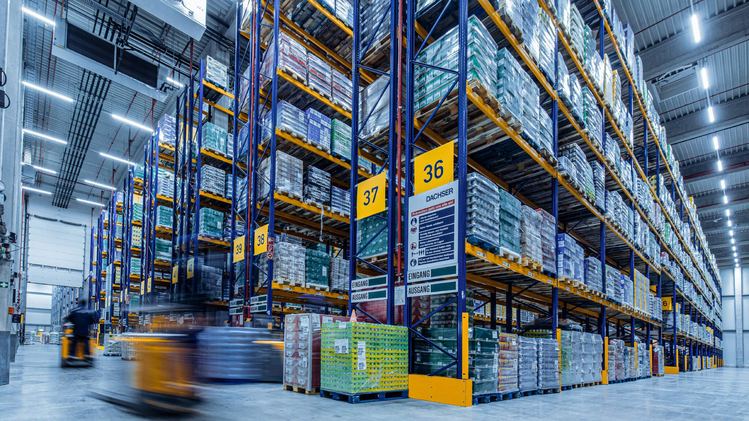
DATA WAREHOUSES
Data warehouses are our vault to solve this issue
Data warehouses have four main pillars – note these as they’re essential for the exam

Slide 9

SUBJECT ORIENTED
Pillar 1: Subject-oriented
Data is organized around high-level entities
Things like Customers, sales
Data is not organized around functional processes
Invoicing, stock taking

Slide 10
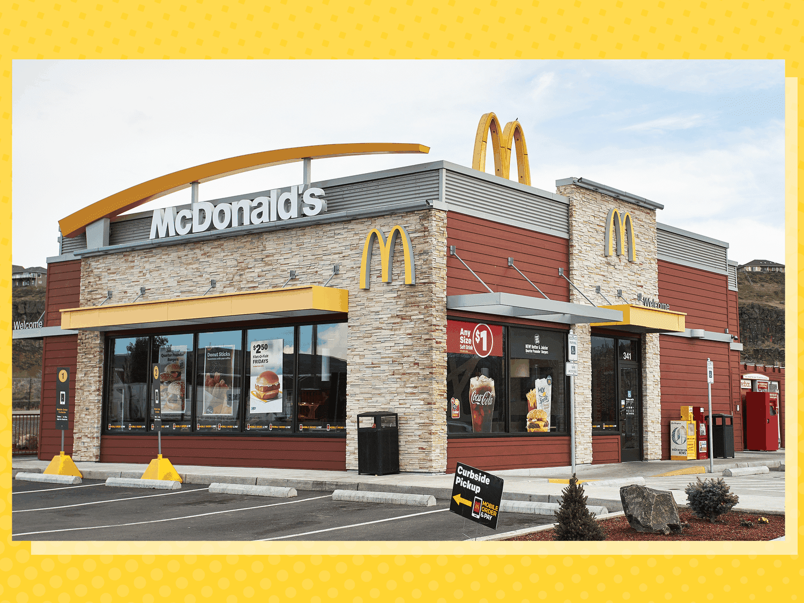
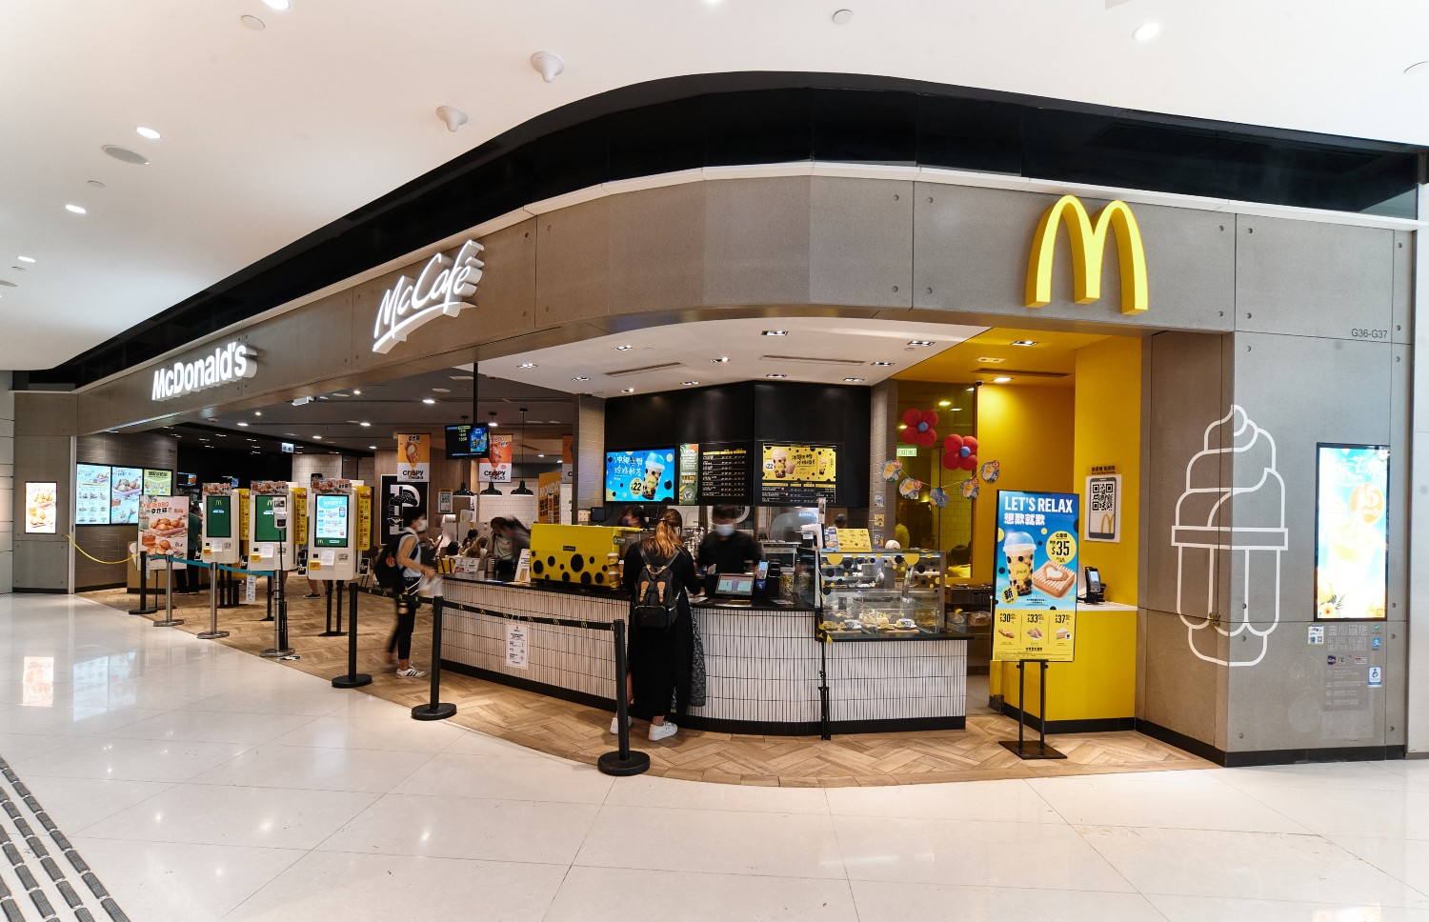
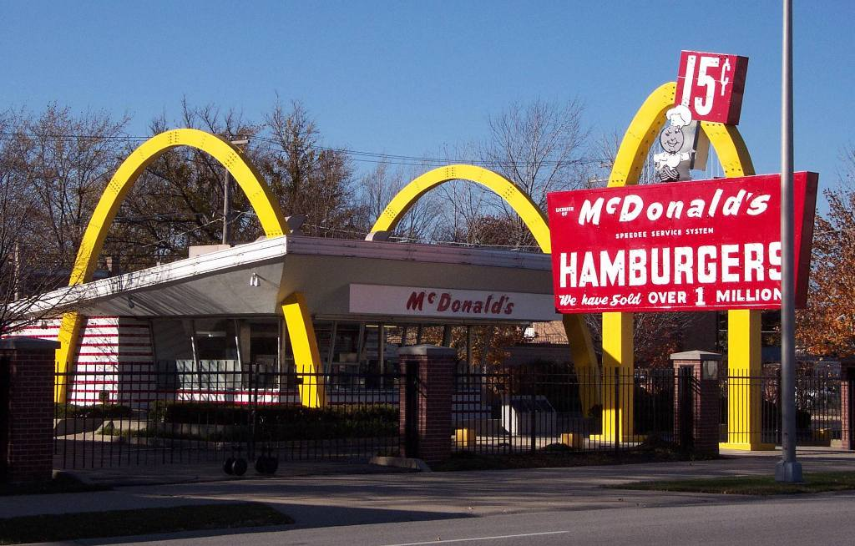
INTEGRATED
Pillar 2: Integrated
Data is gathered from multiple inconsistent sources
Different store branches with different programs
Data is cleaned into a single format

Slide 11
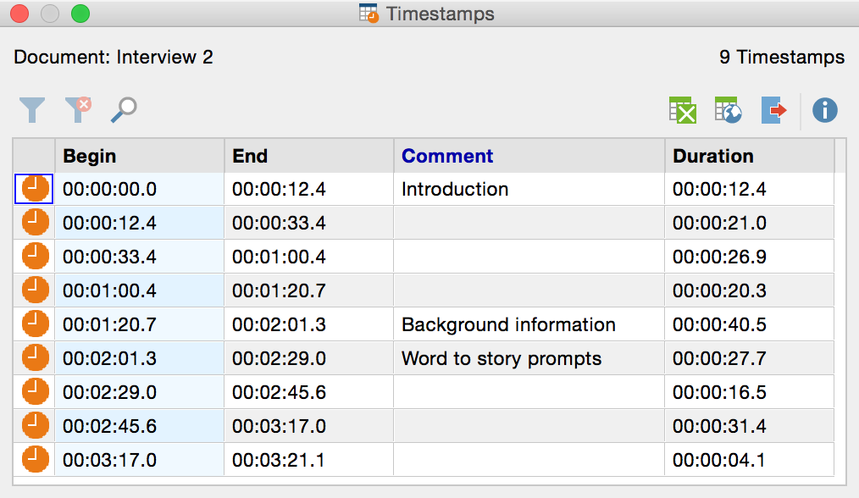
TIME-VARIANT
Pillar 3: Time-variant
Each piece of data is identified with a specific time period
It’s a historical record, not just how it is at the current moment

Slide 12

NON-VOLATILE
Pillar 4: Non-Volatile
When data is entered, it is never changed or deleted
Data is meant to be stable and used for read-only analysis

Slide 13
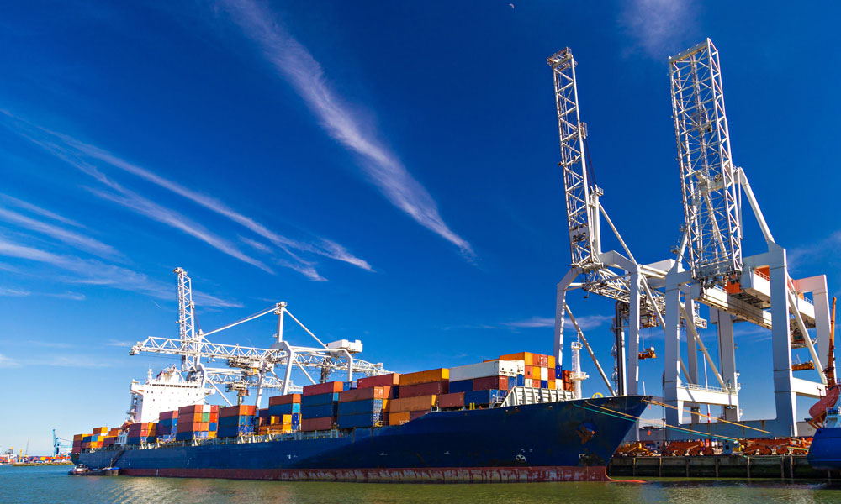
CASE STUDIES
Warehouses are typically used for Strategic Planning and Business Modeling
Example: a multinational company (maybe a shipping company like FedEx) uses a warehouse to decide which ports to invest in based on 20 years of trade data

Slide 14
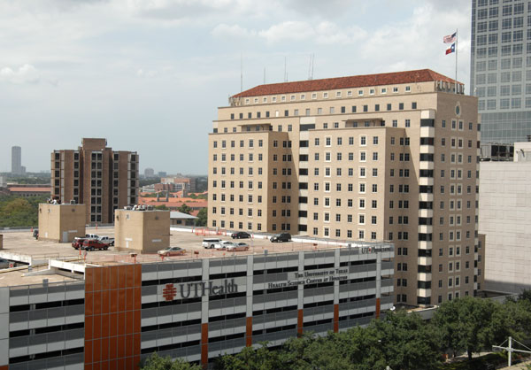
CASE STUDIES
Think of one question that would best be answered by an operational database in a hospital
Think of one question that would best be answered by a data warehouse for a hospital

Slide 15
CASE STUDIES
Small data question: Is there a bed available for this patient right now?
Big data question: Has the average recovery time for heart surgery improved over the last decade across all of our branches?

Slide 16
CASE STUDIES
Customer Name | Address | Cost (£) | Date
Alice Thompson | 12 High St, London, UK | 199.99 | 5/1/2026
Robert Evans | 34 King Rd, Manchester, UK | 349.5 | 7/1/2026
Sophie Carter | 56 Queen Ave, Birmingham, UK | 89.75 | 9/1/2026
Daniel Wright | 78 Park Ln, Leeds, UK | 249 | 10/1/2026
Grace Lewis | 90 Church St, Bristol, UK | 129.99 | 11/1/2026
Henry Walker | 21 Market St, Liverpool, UK | 499 | 12/1/2026
Chloe Adams | 43 Station Rd, Newcastle, UK | 275.25 | 13/01/2026
Oliver Scott | 65 Victoria St, Edinburgh, UK | 150 | 14/01/2026
Here’s data collected about sales from two branches of the same company
Customer Name | Address | Cost (USD) | Date of Purchase
John Smith | 123 Maple St, Austin, TX | 249.99 | 1/5/2026
Sarah Johnson | 456 Oak Ave, Denver, CO | 129.5 | 1/7/2026
Michael Brown | 789 Pine Rd, Seattle, WA | 349 | 1/9/2026
Emily Davis | 321 Birch Ln, Miami, FL | 89.99 | 1/10/2026
David Wilson | 654 Cedar St, Chicago, IL | 199.75 | 1/11/2026
Laura Martinez | 987 Spruce Dr, Phoenix, AZ | 499 | 1/12/2026
James Taylor | 159 Walnut St, Boston, MA | 275.25 | 1/13/2026
Olivia Harris | 753 Elm St, Portland, OR | 150 | 1/14/2026

Slide 17
CASE STUDIES
Customer Name | Address | Cost (£) | Date
Alice Thompson | 12 High St, London, UK | 199.99 | 5/1/2026
Robert Evans | 34 King Rd, Manchester, UK | 349.5 | 7/1/2026
Sophie Carter | 56 Queen Ave, Birmingham, UK | 89.75 | 9/1/2026
Daniel Wright | 78 Park Ln, Leeds, UK | 249 | 10/1/2026
Grace Lewis | 90 Church St, Bristol, UK | 129.99 | 11/1/2026
Henry Walker | 21 Market St, Liverpool, UK | 499 | 12/1/2026
Chloe Adams | 43 Station Rd, Newcastle, UK | 275.25 | 13/01/2026
Oliver Scott | 65 Victoria St, Edinburgh, UK | 150 | 14/01/2026
What’s the conflict between the data in these two locations?
Customer Name | Address | Cost (USD) | Date of Purchase
John Smith | 123 Maple St, Austin, TX | 249.99 | 1/5/2026
Sarah Johnson | 456 Oak Ave, Denver, CO | 129.5 | 1/7/2026
Michael Brown | 789 Pine Rd, Seattle, WA | 349 | 1/9/2026
Emily Davis | 321 Birch Ln, Miami, FL | 89.99 | 1/10/2026
David Wilson | 654 Cedar St, Chicago, IL | 199.75 | 1/11/2026
Laura Martinez | 987 Spruce Dr, Phoenix, AZ | 499 | 1/12/2026
James Taylor | 159 Walnut St, Boston, MA | 275.25 | 1/13/2026
Olivia Harris | 753 Elm St, Portland, OR | 150 | 1/14/2026

Slide 18
CASE STUDIES
Customer Name | Address | Cost (£) | Date
Alice Thompson | 12 High St, London, UK | 199.99 | 5/1/2026
Robert Evans | 34 King Rd, Manchester, UK | 349.5 | 7/1/2026
Sophie Carter | 56 Queen Ave, Birmingham, UK | 89.75 | 9/1/2026
Daniel Wright | 78 Park Ln, Leeds, UK | 249 | 10/1/2026
Grace Lewis | 90 Church St, Bristol, UK | 129.99 | 11/1/2026
Henry Walker | 21 Market St, Liverpool, UK | 499 | 12/1/2026
Chloe Adams | 43 Station Rd, Newcastle, UK | 275.25 | 13/01/2026
Oliver Scott | 65 Victoria St, Edinburgh, UK | 150 | 14/01/2026
How would we store this data in one data warehouse
Customer Name | Address | Cost (USD) | Date of Purchase
John Smith | 123 Maple St, Austin, TX | 249.99 | 1/5/2026
Sarah Johnson | 456 Oak Ave, Denver, CO | 129.5 | 1/7/2026
Michael Brown | 789 Pine Rd, Seattle, WA | 349 | 1/9/2026
Emily Davis | 321 Birch Ln, Miami, FL | 89.99 | 1/10/2026
David Wilson | 654 Cedar St, Chicago, IL | 199.75 | 1/11/2026
Laura Martinez | 987 Spruce Dr, Phoenix, AZ | 499 | 1/12/2026
James Taylor | 159 Walnut St, Boston, MA | 275.25 | 1/13/2026
Olivia Harris | 753 Elm St, Portland, OR | 150 | 1/14/2026

Slide 19
CASE STUDIES
Customer Name | Address | Cost (USD) | Date
John Smith | 123 Maple St, Austin, TX | 249.99 | 1/5/2026
Sarah Johnson | 456 Oak Ave, Denver, CO | 129.5 | 1/7/2026
Michael Brown | 789 Pine Rd, Seattle, WA | 349 | 1/9/2026
Emily Davis | 321 Birch Ln, Miami, FL | 89.99 | 1/10/2026
David Wilson | 654 Cedar St, Chicago, IL | 199.75 | 1/11/2026
Laura Martinez | 987 Spruce Dr, Phoenix, AZ | 499 | 1/12/2026
James Taylor | 159 Walnut St, Boston, MA | 275.25 | 1/13/2026
Olivia Harris | 753 Elm St, Portland, OR | 150 | 1/14/2026
Alice Thompson | 12 High St, London, UK | 267.9866 | 1/5/2026
Robert Evans | 34 King Rd, Manchester, UK | 468.33 | 1/7/2026
Sophie Carter | 56 Queen Ave, Birmingham, UK | 120.265 | 1/9/2026
Daniel Wright | 78 Park Ln, Leeds, UK | 333.66 | 1/10/2026
Grace Lewis | 90 Church St, Bristol, UK | 174.1866 | 1/11/2026
Henry Walker | 21 Market St, Liverpool, UK | 668.66 | 1/12/2026
Chloe Adams | 43 Station Rd, Newcastle, UK | 368.835 | 1/13/2026
Oliver Scott | 65 Victoria St, Edinburgh, UK | 201 | 1/14/2026
We would need to transform the data from one table to match the other
We’ll change the UK table to match US
Then, we can combine the data together into one table

Slide 20
CASE STUDIES
Customer Name | Address | Cost (USD) | Date
John Smith | 123 Maple St, Austin, TX | 249.99 | 1/5/2026
Sarah Johnson | 456 Oak Ave, Denver, CO | 129.5 | 1/7/2026
Michael Brown | 789 Pine Rd, Seattle, WA | 349 | 1/9/2026
Emily Davis | 321 Birch Ln, Miami, FL | 89.99 | 1/10/2026
David Wilson | 654 Cedar St, Chicago, IL | 199.75 | 1/11/2026
Laura Martinez | 987 Spruce Dr, Phoenix, AZ | 499 | 1/12/2026
James Taylor | 159 Walnut St, Boston, MA | 275.25 | 1/13/2026
Olivia Harris | 753 Elm St, Portland, OR | 150 | 1/14/2026
Alice Thompson | 12 High St, London, UK | 267.9866 | 1/5/2026
Robert Evans | 34 King Rd, Manchester, UK | 468.33 | 1/7/2026
Sophie Carter | 56 Queen Ave, Birmingham, UK | 120.265 | 1/9/2026
Daniel Wright | 78 Park Ln, Leeds, UK | 333.66 | 1/10/2026
Grace Lewis | 90 Church St, Bristol, UK | 174.1866 | 1/11/2026
Henry Walker | 21 Market St, Liverpool, UK | 668.66 | 1/12/2026
Chloe Adams | 43 Station Rd, Newcastle, UK | 368.835 | 1/13/2026
Oliver Scott | 65 Victoria St, Edinburgh, UK | 201 | 1/14/2026
In a normal database, if a customer moved from London to New York, what would we do?

Slide 21
CASE STUDIES
Customer Name | Address | Cost (USD) | Date
John Smith | 123 Maple St, Austin, TX | 249.99 | 1/5/2026
Sarah Johnson | 456 Oak Ave, Denver, CO | 129.5 | 1/7/2026
Michael Brown | 789 Pine Rd, Seattle, WA | 349 | 1/9/2026
Emily Davis | 321 Birch Ln, Miami, FL | 89.99 | 1/10/2026
David Wilson | 654 Cedar St, Chicago, IL | 199.75 | 1/11/2026
Laura Martinez | 987 Spruce Dr, Phoenix, AZ | 499 | 1/12/2026
James Taylor | 159 Walnut St, Boston, MA | 275.25 | 1/13/2026
Olivia Harris | 753 Elm St, Portland, OR | 150 | 1/14/2026
Alice Thompson | 12 High St, London, UK | 267.9866 | 1/5/2026
Robert Evans | 34 King Rd, Manchester, UK | 468.33 | 1/7/2026
Sophie Carter | 56 Queen Ave, Birmingham, UK | 120.265 | 1/9/2026
Daniel Wright | 78 Park Ln, Leeds, UK | 333.66 | 1/10/2026
Grace Lewis | 90 Church St, Bristol, UK | 174.1866 | 1/11/2026
Henry Walker | 21 Market St, Liverpool, UK | 668.66 | 1/12/2026
Chloe Adams | 43 Station Rd, Newcastle, UK | 368.835 | 1/13/2026
Oliver Scott | 65 Victoria St, Edinburgh, UK | 201 | 1/14/2026
We would generally change their address, and that would change all previous records
In a data warehouse, we keep the previous record and would only update new records
Time variance and non-volatility

Slide 22
CASE STUDIES
Customer Name | Address | Cost (USD) | Date
John Smith | 123 Maple St, Austin, TX | 249.99 | 1/5/2026
Sarah Johnson | 456 Oak Ave, Denver, CO | 129.5 | 1/7/2026
Michael Brown | 789 Pine Rd, Seattle, WA | 349 | 1/9/2026
Emily Davis | 321 Birch Ln, Miami, FL | 89.99 | 1/10/2026
David Wilson | 654 Cedar St, Chicago, IL | 199.75 | 1/11/2026
Laura Martinez | 987 Spruce Dr, Phoenix, AZ | 499 | 1/12/2026
James Taylor | 159 Walnut St, Boston, MA | 275.25 | 1/13/2026
Olivia Harris | 753 Elm St, Portland, OR | 150 | 1/14/2026
Alice Thompson | 12 High St, London, UK | 267.9866 | 1/5/2026
Robert Evans | 34 King Rd, Manchester, UK | 468.33 | 1/7/2026
Sophie Carter | 56 Queen Ave, Birmingham, UK | 120.265 | 1/9/2026
Daniel Wright | 78 Park Ln, Leeds, UK | 333.66 | 1/10/2026
Grace Lewis | 90 Church St, Bristol, UK | 174.1866 | 1/11/2026
Henry Walker | 21 Market St, Liverpool, UK | 668.66 | 1/12/2026
Chloe Adams | 43 Station Rd, Newcastle, UK | 368.835 | 1/13/2026
Oliver Scott | 65 Victoria St, Edinburgh, UK | 201 | 1/14/2026
This whole process is known as ETL:
Extract the data
Transform it to the correct format
Load it into the warehouse

Slide 23
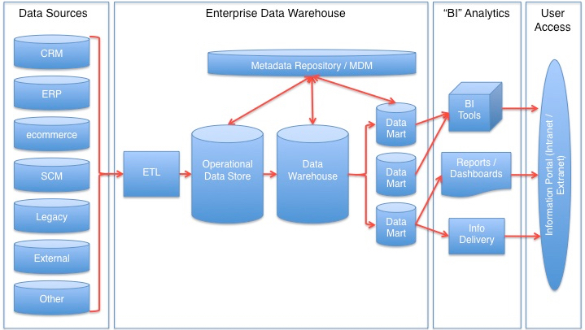
REAL-TIME REFRESH
One more small note:
If an organization has a data warehouse, they’ll need to send updates to the warehouse every few minutes from the operational database
This is known as a real-time-refresh

Slide 24

ADVANTAGES
Single manageable structure: much easier for IT to maintain just one analysis source
Complex Queries: Allows joining of data from HR, Sales, Logistics, that were previously in separate systems

Slide 25
LAB QUESTION
A global airline uses a data warehouse to manage its frequent flyer program and flight schedules
State why the airline’s data warehouse is considered “non-volatile” [1]
Outline one reason why “time-variance” is essential for the airline’s strategic planning [2]

Slide 26
LAB QUESTION
State why the airline’s data warehouse is considered “non-volatile” [1]
Because once the flight or passenger data is loaded into the warehouse, it is not deleted or changed/it remains as a permanent historical record.
Outline one reason why “time-variance” is essential for the airline’s strategic planning [2]
Award 1 mark for: Data is only valid for a specific time/is time-stamped.
Award 1 mark for: This allows the airline to compare current performance against past years to identify long-term trends in passenger numbers.

Slide 27

VOCAB TO REMEMBER
Operational Database
Data Warehouse
Subject Oriented
Integrated
Time-variant
Non-volatile
Real-time-refresh

